Slide 1
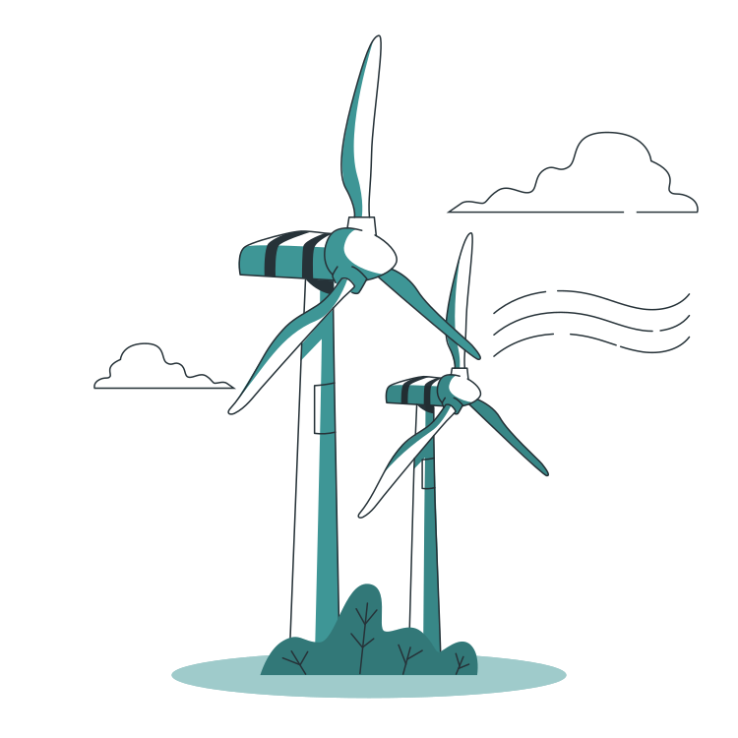

An Analysis of Long Duration Energy Storage For Wind Farms
Reynolds Li
Avangrid 2024 Clean Energy Hackathon

Slide 2
Table of Contents
Energy Data Analysis
Wind Energy Production Analysis
Variability Analysis
Curtailment Levels Analysis
LDES Technology Analysis
Economic Viability
Energy Storage Technology Incentives
Optimization Model
Optimization Model Results
Forward Forecasting and Overall Viability
ISO/Regional Constraints
ISO/Regional Constraints
ISO/Regional Constraints (Cont.)
Sustainability and Scalability
Sustainability
Scalability
Recommendation Summary
Table of Contents

Slide 3
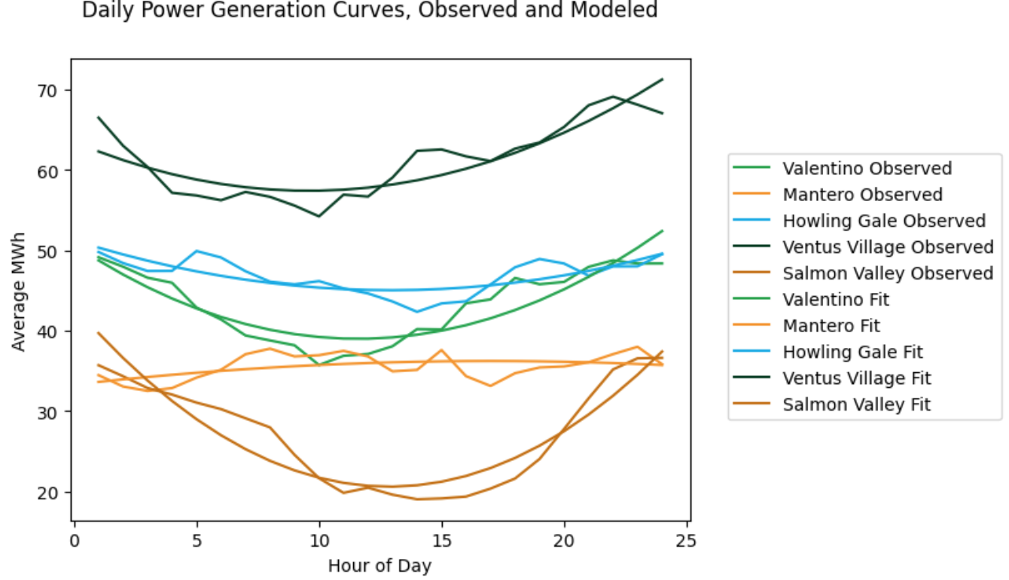
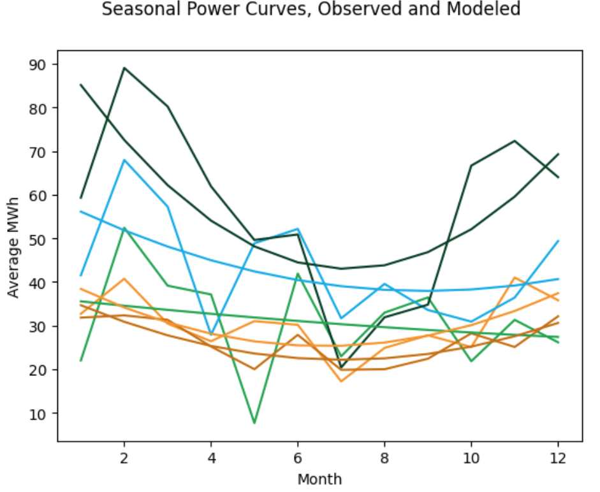
Wind Energy Production Analysis
Wind energy was analyzed via the generation of average energy output plots over both a diurnal and annual cycle
Zero generation values were assumed to imply curtailed production, although they could simply represent instantaneous low wind resource
Second-order polynomials were fitted to the data to remove noise
Ventus Village has the highest average wind resource
1
Energy Data Analysis
Energy Data Analysis

Slide 4
Variability Analysis
Variability was analyzed by using the standard deviation of the energy output to the grid over both daily and monthly timescales as a proxy
Seasonal variability is slightly larger than daily variability
Salmon Valley has the largest daily variability, while Ventus Village has the largest seasonal variability
Salmon Valley also has the largest variability in price
Site: | Valentino | Mantero | Howling Gale | Ventus Village | Salmon Valley
Daily Variability: | 4.32 MWh | 1.62 MWh | 2.11 MWh | 4.43 MWh | 6.26 MWh
Seasonal Variability: | 11.22 MWh | 6.51 MWh | 11.66 MWh | 19.41 MWh | 4.75 MWh
2
Energy Data Analysis
Energy Data Analysis

Slide 5
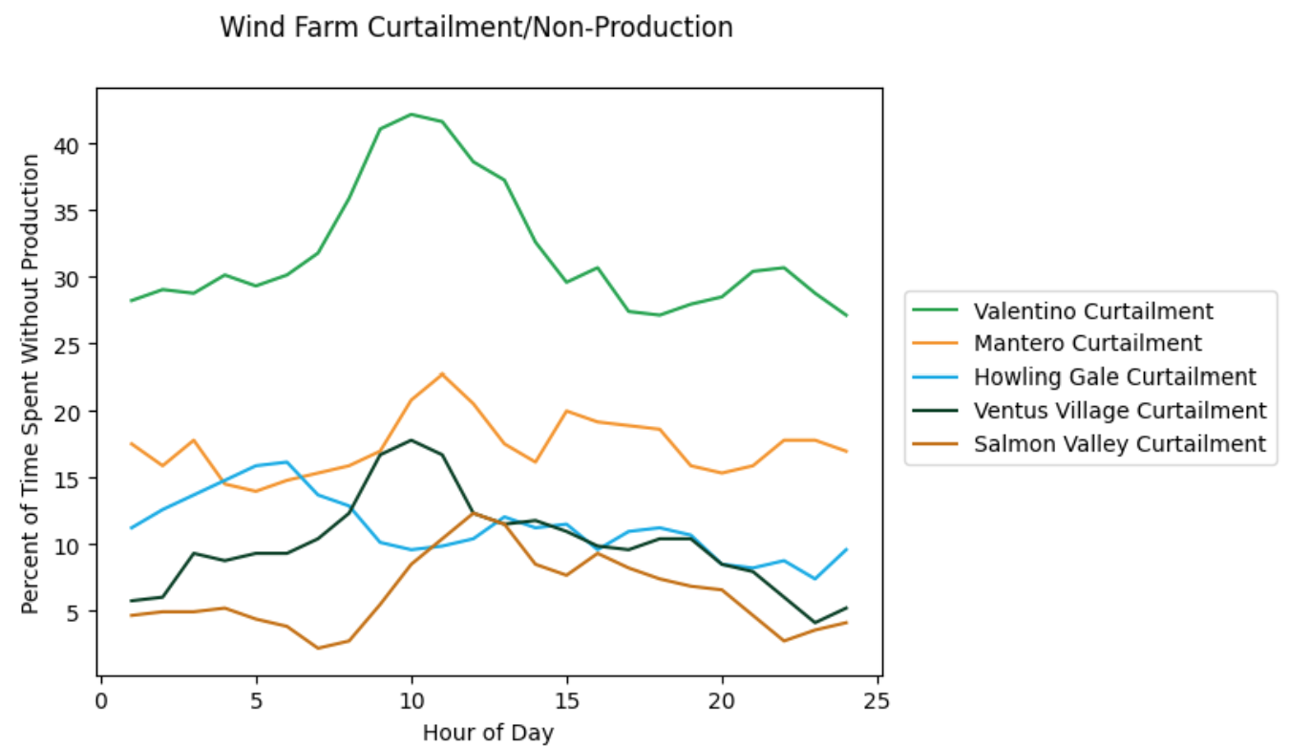
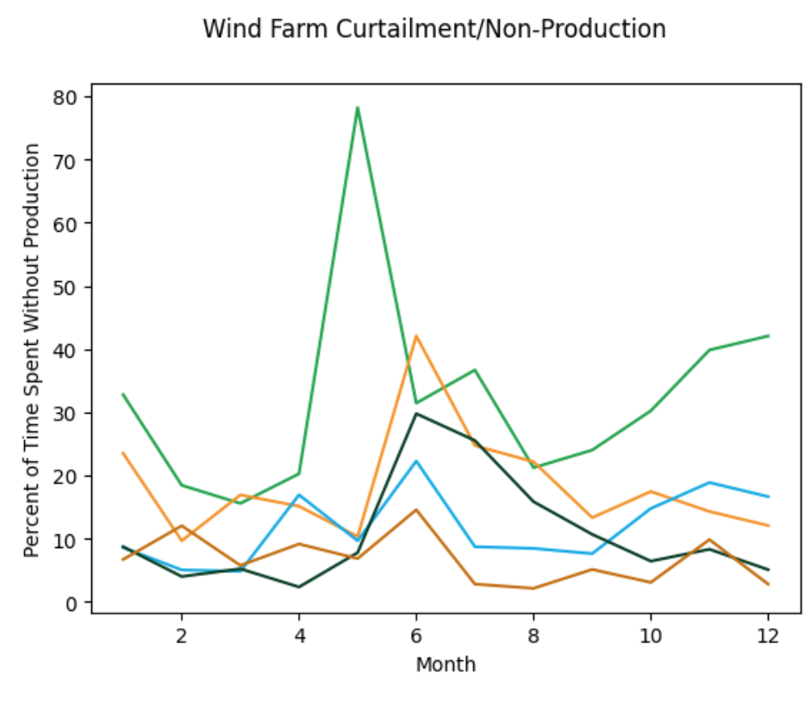
Curtailment Analysis
Curtailment periods, assumed to be when there is zero output to the grid, were counted daily and monthly to determine the levels and times spent curtailed
Curtailment levels average around 15% of the time, with higher curtailment in summer and during midday due to a combination of high production and lower demand
Anomalous curtailment of the Valentino site in May which may indicate a longer-term shutdown
3
Energy Data Analysis
Energy Data Analysis

Slide 6
LDES Technology Analysis
LDES use electrochemical, chemical, mechanical and thermal storage methods
Electrochemical & mechanical have the lowest LCOS (Levelized Cost of Storage)
Mechanical methods are geographically limited (need rivers, aquifers, or caves)
For long-duration uses, flow batteries are cheapest
Vanadium flow batteries have high conversion efficiency, easy charging, long cycle life, are a commercially available technology, and the most popular form of flow battery for LDES
4
Energy Data Analysis
Energy Data Analysis

Slide 7
Energy Storage Technology Incentives
State incentives for each site:
PNW: The Oregon Department of Energy has up to $50,000 per Oregon county available for LDES installation, with a total of $1.8 million.
MISO: Minnesota provides grants for energy storage projects through the RDF. Grant amounts vary based on project scope and are awarded on a competitive basis. Available awards can reach $500,000.
PJM: Pennsylvania's Alternative Energy Production Tax Credit offers eligible projects a tax credit equal to 15% of the project's total development, equipment, and construction costs, capped at $1 million per taxpayer.
EORC: No applicable state incentives.
Federal incentives for all sites:
Investment Tax Credit (ITC): The Inflation Reduction Act (IRA) of 2022 expanded the ITC to include standalone energy storage systems, offering a 30% tax credit for projects commencing construction between 2023 and 2024.
5
Economic Viability
Economic Viability

Slide 8
Optimization Model
An optimization model was developed to calculate the total extra annual revenue, reduction in curtailment, and extra grid utilization for a given LDES capacity, considering the cost of system installation
A simple thresholding system was assumed to determine when to charge and discharge the LDES where it was charged whenever the system was curtailed, and whenever the price increased beyond a certain threshold it was discharged, with the charge and discharge rates calculated from parameters
High prices were assumed to correlate with high demand and thus the ability to successfully sell excess power discharged from the LDES system to the grid
Fitted wind curves were used to estimate wind resources during curtailments
The model was built in Python, using the NumPy, Pandas, and SciPy packages, and the optimization uses a Nelder-Mead gradient descent optimization algorithm
6
Economic Viability
Economic Viability

Slide 9
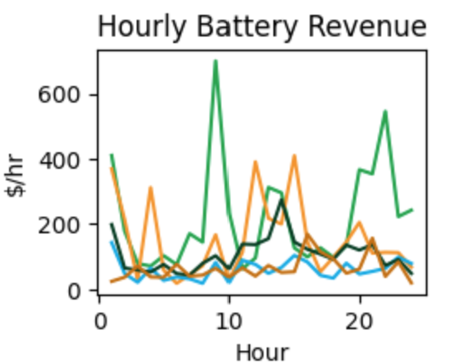
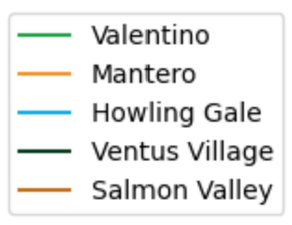
Optimization Model Results
The optimal capacity for the LDES was 36.5 MW at the Valentino site
It reduced variability by 38.3%
Annual revenue in 2023 would have been increased by $1.92M
It would have led to the utilization of an extra 54,932 MWh of generated power, increasing market participation
The majority of this added revenue comes from storage from excess curtailed production in the morning and discharge at higher demand and price times in the evening
7
Economic Viability
Economic Viability

Slide 10
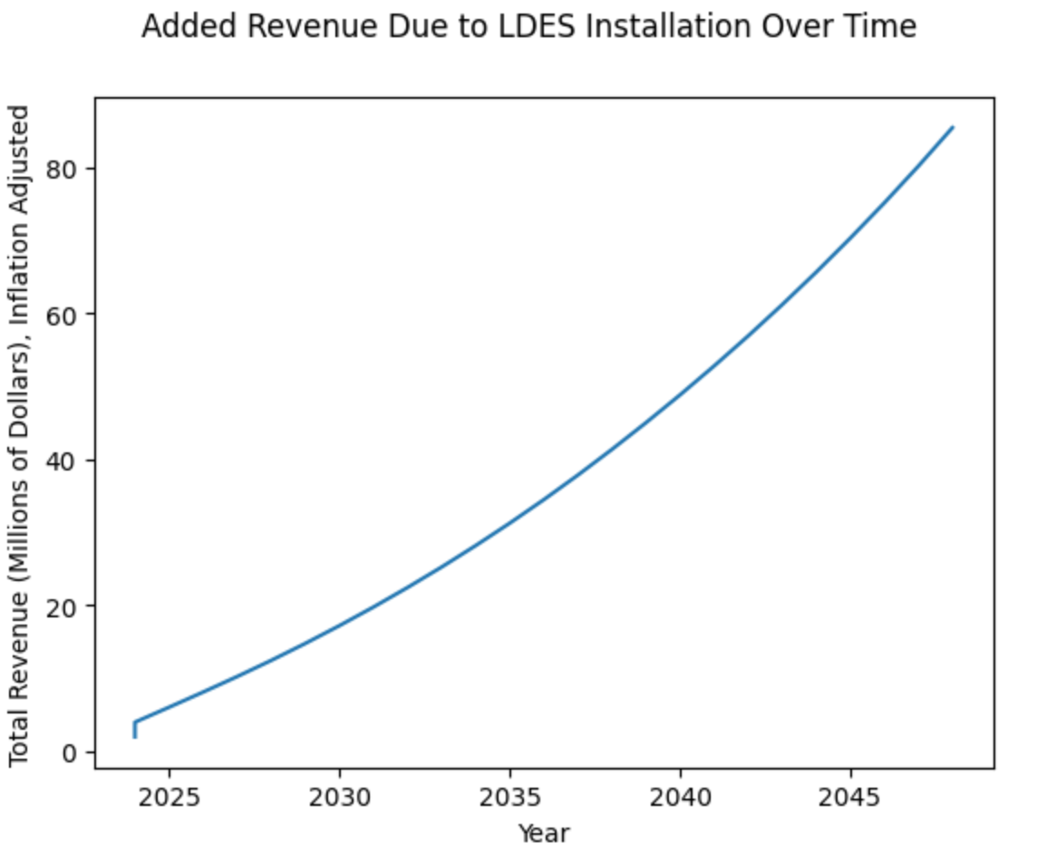
Forward Forecasting and Overall Viability
Optimization model results from the revenue from 2023 were used as a basis, combined with predictions from the EIA of future power prices and variability, were used to calculate inflation-adjusted predictions of added revenue from the LDES over time.
This was then combined with estimates for the CAPEX and OPEX of the LDES system, as well as tax incentives, to determine net total added revenue, which is $12.4M over a 25-year lifetime.
The system is thus economically viable
8
Economic Viability
Economic Viability

Slide 11
ISO/Regional Constraints
Valentino:
PNW has ambitious renewable goals, focusing on balancing hydro and wind. PNW has significant hydroelectric power, so wind curtailment may occur during high river flows. Investing in LDES is essential for capturing the curtailment, and supporting a more stable renewable mix. However, PNW regulated markets impose stricter environmental standards, and interconnection costs can be high due to less market competition, which needs further investigations.
Mantero and Howling Gale:
MISO spans a large geographic area with high wind potential but also high congestion potential. LDES could reduce congestion costs and increase revenue by reducing the need for transmission during peak production. MISO market is unregulated and allows for merchant market flexibility, which is favorable for arbitrage but has varying interconnection rules across states that limit the scalability of the project.
9
ISO/Regional Constraints

Slide 12
ISO/Regional Constraints (Cont.)
Ventus Village:
PJM’s congestion issues are less severe. PJM’s competitive market offers multiple revenue opportunities through ancillary services and capacity markets, enhancing the business case for LDES. With diverse energy sources ranging from nuclear to solar power, PJM focuses on balanced integration. LDES face scalability limits and can only help mitigate potential over-reliance on any one type of renewable resource, especially during seasonal variability.
Salmon Valley:
ERCOT’s isolation from other grids creates extreme price volatility during high-demand periods. LDES could capitalize on this by discharging during peak periods and charging during off-peak. ERCOT’s competitive market lacks stringent regulation but is vulnerable to severe price swings. This instability could increase LDES revenue but also carries operational risk.
10
ISO/Regional Constraints

Slide 13
Sustainability
Valentino (PNW): With hydro-heavy grid contributions, Valentino could see major benefits from LDES in reduced wind curtailment, which is enormous because of the hydropower supply that lowers the demand for wind farm power. The savings from curtailment offset carbon emissions from other sources.
Mantero and Howling Gale (MISO): By reducing curtailment and supporting more stable renewable energy, LDES could provide substantial decarbonization benefits in MISO. It could also reduce dependence on transmission expansion, preserving land and resources.
Ventus Village (PJM): LDES could offer incremental benefits by balancing diverse renewable sources, which may reduce the need for peaker plants and help stabilize emissions.
Salmon Valley (ERCOT): LDES could reduce emissions by capturing and utilizing wind energy that would otherwise be curtailed. In the Texas market, which frequently resorts to gas-fired power plants for generation, the environmental benefits are significant.
11
Sustainability and Scalability

Slide 14
Sustainability and Scalability
Long-Term Sustainability Benefits: LDES at each site could enable higher renewable penetration over time, as storage enables grids to absorb more variable generation. This aligns with national and regional decarbonization goals, especially as renewable targets increase.
Challenges:
PNW: Scalability potential is high due to the enormous curtailments level, but slow growth may be expected due to strict regulation and hydropower market substitutions.
MISO: Scalability is promising but may require additional infrastructure for interconnections to manage regional grid diversity.
PJM: Due to market flexibility, PJM has high scalability potential, but competition with other energy sources may slow adoption.
ERCOT: Scalability is high due to ERCOT’s need for grid stability; however, dependency on a single state’s incentives and regulatory environment could be limiting.
12
Sustainability and Scalability

Slide 15
Recommendation Summary
Based on these analyses we propose to install a 36.5 MW vanadium redox flow battery at the Valentino site, which will:
Reduce variability by 38.3%
Generate a net increase in revenue of $12.4M over a 25-year lifetime
Deliver an additional 54,932 MWh to the grid annually
Environmental Benefits:
The vanadium flow battery enables effective use of wind energy that would otherwise be curtailed due to hydro dominance, offsetting emissions from other fossil-based sources
Consideration of Challenges:
Scalability potential is high due to curtailments, but rate limited due to tight regulation and high hydropower usage in PNW
Overall, the Valentino site has high sustainability and scalability potential, will generate the highest amount of revenue, and help PNW reach their ambitious renewable goals
14
Recommendation Summary

Slide 16
Works Cited
https://www.pwc.com.au/legal/assets/is-merchant-the-new-black-may18.pdf
https://www.eia.gov/todayinenergy/detail.php?id=62406
https://www.nrel.gov/news/program/2022/reframing-curtailment.html
https://www.nrel.gov/docs/fy17osti/68960.pdf
https://www.energy.gov/sites/default/files/2024-08/Achieving%20the%20Promise%20of%20Low-Cost%20Long%20Duration%20Energy%20Storage_FINAL_08052024.pdf
https://decarbonization.visualcapitalist.com/all-commercially-available-long-duration-energy-storage-technologies-in-one-chart/
https://www.energy.gov/sites/default/files/2024-08/Achieving%20the%20Promise%20of%20Low-Cost%20Long%20Duration%20Energy%20Storage_FINAL_08052024.pdf
https://www.technologyreview.com/2022/02/23/1046365/grid-storage-iron-batteries-technology/
https://www.mckinsey.com/capabilities/sustainability/our-insights/net-zero-power-long-duration-energy-storage-for-a-renewable-grid
https://www.offgridenergyindependence.com/articles/31141/the-time-for-long-duration-energy-storage-is-coming
https://www.globalxetfs.com/short-and-long-duration-energy-storage-essential-to-the-clean-energy-transition/
https://www.nature.com/articles/s41560-021-00796-8
https://www.bestmag.co.uk/flow-batteries-top-does-long-duration-energy-storage-cost-comparison/
https://www.nrel.gov/docs/fy23osti/85878.pdf
https://www.cell.com/joule/fulltext/S2542-4351(20)30325-1
https://www.cell.com/joule/fulltext/S2542-4351(21)00306-8
https://www.sciencedirect.com/science/article/pii/S2542435119305392
https://www.frontiersin.org/journals/energy-research/articles/10.3389/fenrg.2020.527910/full
https://ieeexplore.ieee.org/document/6889042
https://www.slenergystorage.com/documents/20190626_Long_Duration%20Storage_Costs.pdf
https://www.mckinsey.com/~/media/mckinsey/business%20functions/sustainability/our%20insights/net%20zero%20power%20long%20duration%20energy%20storage%20for%20a%20renewable%20grid/net-zero-power-long-duration-energy-storage-for-a-renewable-grid.pdf
15
Works Cited

